Slide 1
Voice To Macro
Naman Vohra
Nicholas Jovanka
Rino Santoso
Salya Wirachman

Slide 2
Problem
We saw that there are 2 main problems in terms of shortcut usage which are:
Inconvenient Key Combinations
Memorization
The first problem stems from key combinations that are uncomfortable or unorthodox to press. such examples are Ctrl + Shift + Esc making your hand shape twist in an unnatural way. Research states that using a keyboard for a long period of time causes injuries to the hand due to its design forcing your hand to over stretch on some keystrokes.
The second problem is the huge amount of shortcuts that exist. Each program could average around 40-50 Shortcuts, that means there are thousands of key shortcuts that are programmed by the creator’s sense of logic.

Slide 3
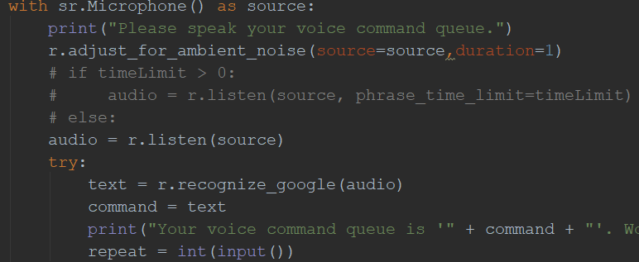
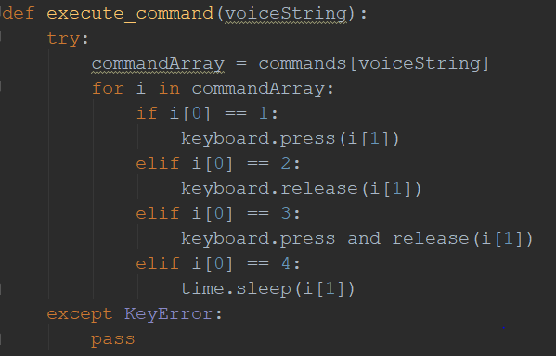
Program
Listens for audio input from a microphone
Recognizes string or integer from audio file
Correlate the keyword to an action type
Simulate Key Presses in the windows virtual keyboard

Slide 4
Implementation Details
Utilizing the Speech Recognition Library gather an audio input from a mic.
Take the audio file and convert audio into text based on their datatype.
Using a Lexemizer to create Text Validation when creating a command phrase.
Creates a Dictionary and uses command as the key and the value as action type and which key to press.
Waits till user calls the command. Then simulate key presses on a virtual keyboard.
Lastly have a Save Function for user made commands after the program closes.

Slide 5
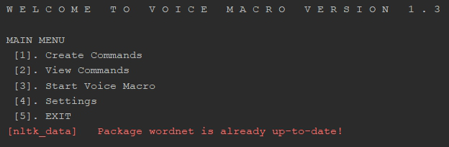
Voice To Macro
Demo

Slide 6
Conclusion
In Conclusion our program of aiming to create a voice to macro program to solve the problem of memorization, inconvenient key combinations, and motoric requirement to activate shortcuts were achieved by the program that we created..

